Slide 1


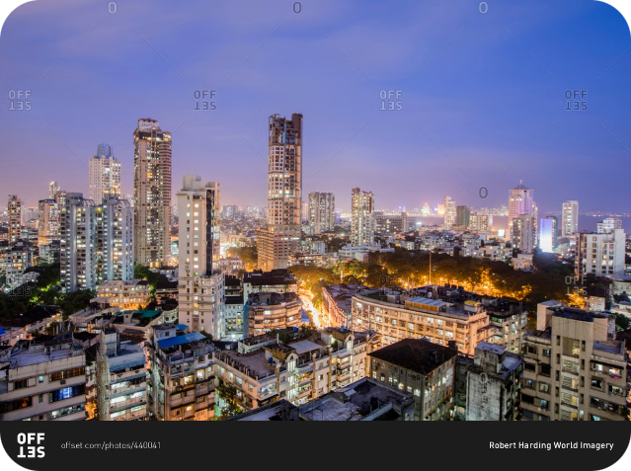


Foreign Direct Investment in India
India has emerged as a global investment hub, attracting substantial foreign direct investment (FDI) over the past two decades. This presentation will delve into the sector-wise and year-wise trends of FDI in India from 2000-01 to 2016-17.
by Nikhil Yadav

Slide 2

Sector-wise FDI Analysis (2000-01 to 2016-17)
Key Sectors
Diverse Investments
Changing Landscape
The sectors that have attracted the highest FDI include services, computer software and hardware, telecommunications, construction development, and trading.
FDI has flowed into a wide range of industries, reflecting India's economic diversification and the government's efforts to liberalize the investment climate.
The composition of FDI has evolved over time, with some sectors gaining prominence while others have seen a decline in investment.

Slide 3
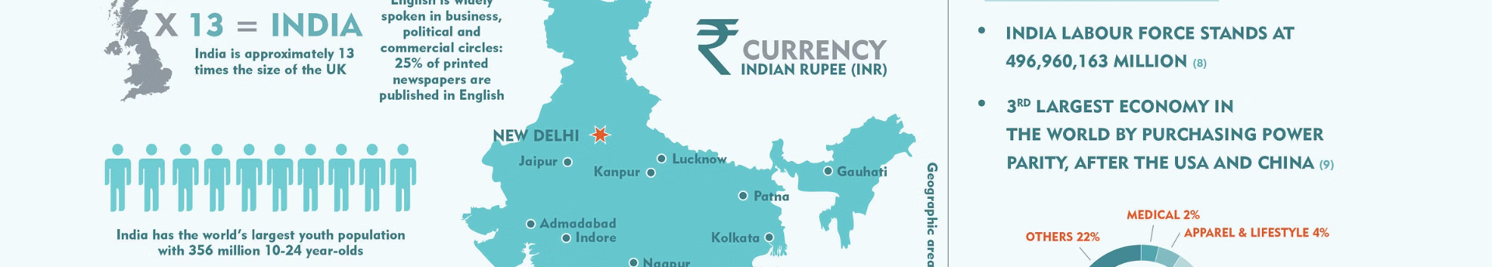
Top Sectors Attracting FDI
1
Services Sector
2
Computer Software and Hardware
This sector, including financial, banking, insurance, and outsourcing, has consistently been the top recipient of FDI.
India's thriving technology ecosystem has drawn substantial FDI, making this sector a close second.
3
Telecommunications
4
Construction Development
The rapid growth of the telecom industry has attracted significant foreign investment over the years.
The real estate and infrastructure sectors have also been major beneficiaries of FDI inflows.

Slide 4

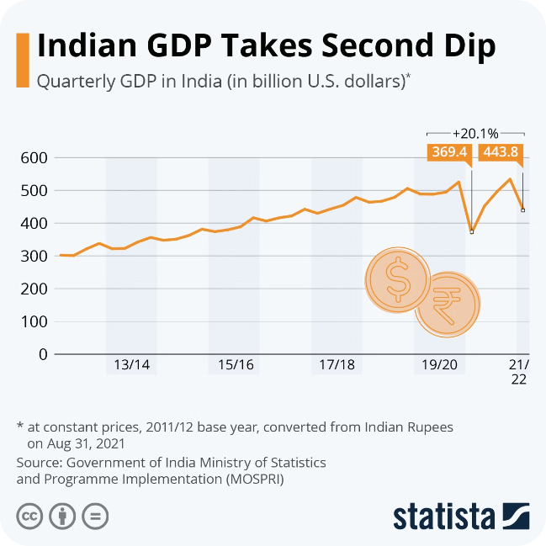
Trends in Sector-wise FDI
1
Emerging Sectors
The e-commerce, renewable energy, and defense sectors have gained prominence in recent years, attracting increased FDI.
2
Shifting Priorities
The government's focus on Make in India and infrastructure development has led to a rise in FDI in manufacturing and construction.
3
Changing Landscape
The composition of FDI has evolved, reflecting India's economic transformation and the government's policy changes.

Slide 5

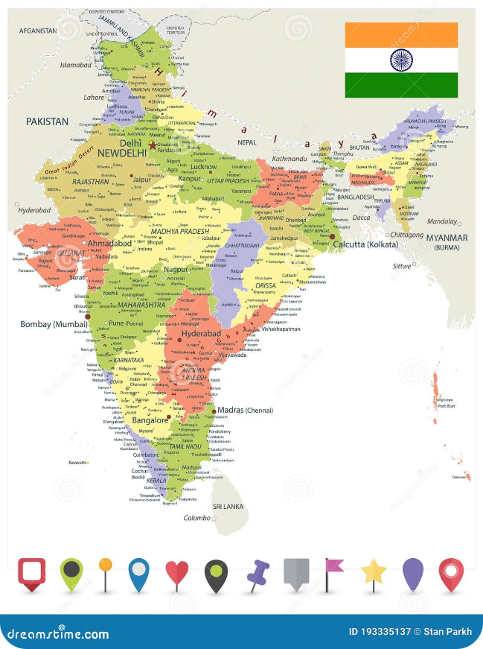



Year-wise FDI Analysis (2000-01 to 2016-17)
Steady Growth
FDI inflows have shown a consistent upward trend over the past 17 years, with some fluctuations.
Policy Reforms
The government's initiatives to liberalize the investment climate and improve the ease of doing business have contributed to the growth in FDI.
Global Factors
Macroeconomic conditions, both domestic and international, have influenced the fluctuations in annual FDI inflows.

Slide 6

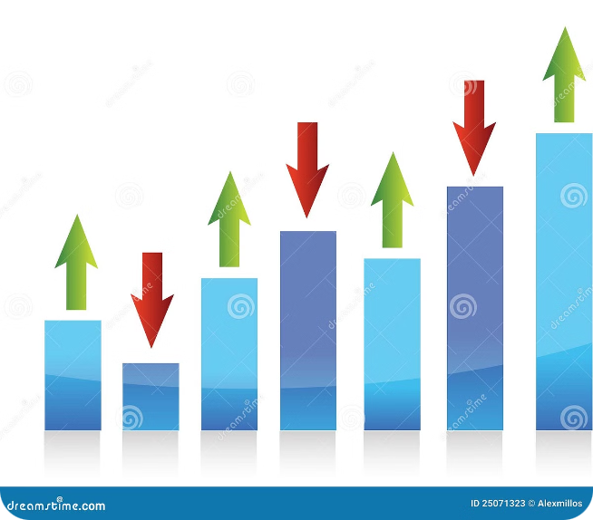
Fluctuations in Annual FDI Inflows
1
Global Recession
The global financial crisis of 2008-09 led to a temporary dip in FDI, as international investors adopted a more cautious approach.
2
Policy Initiatives
The government's efforts to streamline regulations and improve the investment climate have helped to maintain a steady upward trend in FDI.
3
Sectoral Shifts
The changing composition of FDI, with some sectors gaining prominence while others decline, has contributed to the fluctuations in annual inflows.

Slide 7


Factors Influencing FDI in India
Economic Reforms
Market Potential
India's ongoing economic liberalization, with policies to promote investment, has been a key driver of FDI.
India's large and growing consumer base, along with its expanding middle class, has made it an attractive destination for foreign investors.
Skilled Workforce
Favorable Policies
India's abundance of skilled and cost-competitive labor, particularly in the technology and services sectors, has been a significant draw for FDI.
The government's efforts to simplify regulations, improve infrastructure, and provide incentives have made India a more investor-friendly destination.

Slide 8


Conclusion and Key Takeaways
1
Sustained Growth
2
Diverse Sectors
FDI inflows to India have shown a steady upward trend, reflecting the country's appeal as a global investment destination.
FDI has flowed into a wide range of industries, showcasing the breadth and depth of India's economy.
3
Policy Reforms
4
Future Potential
The government's efforts to improve the investment climate have played a crucial role in attracting and retaining FDI.
With continued policy reforms and economic growth, India is poised to attract even more foreign direct investment in the years to come.

